Slide 1
Peer to peer chat app using python

Slide 2
Network Services
There are two levels to access network services
The low level: At low level, networking is provided by basic socket support which is supported by the operating system
The high level: We use high level libraries which provide access to application level network protocol such as FTP or HTTP.
For this webinar, we will be focusing on low level i.e. developing our app using sockets

Slide 3
Why Python?
Popularity and huge user base
Shorter and simpler syntax
Huge database of libraries created by users

Slide 4
Sockets
Socket also known as node, are the endpoints of the communication.
Communication can happen among process on same machine or processes on different machines.
One socket(node) listens on a particular port at an IP, while other socket reaches out to the other to form a connection. Server forms the listener socket while client reaches out to the server.

Slide 5
A brief history of sockets
Sockets have a long history. Their use originated with ARPANET in 1971 and later became an API in the Berkeley Software Distribution (BSD) operating system released in 1983 called Berkeley sockets.
When the Internet took off in the 1990s with the World Wide Web, so did network programming. Web servers and browsers weren’t the only applications taking advantage of newly connected networks and using sockets. Client-server applications of all types and sizes came into widespread use.
Today, although the underlying protocols used by the socket API have evolved over the years, and we’ve seen new ones, the low-level API has remained the same.

Slide 6
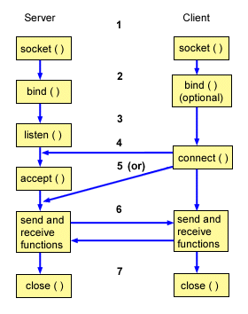
Working of socket

Slide 7
Hands on Session
Server Socket application

Slide 8
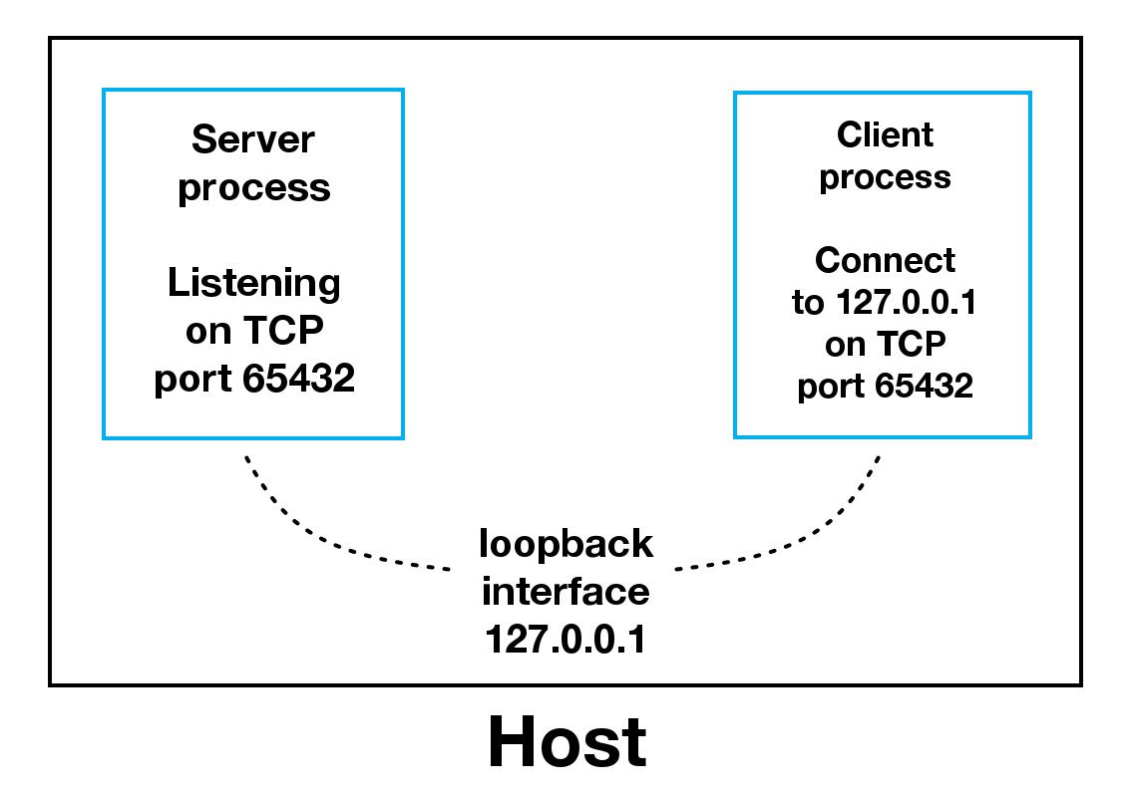
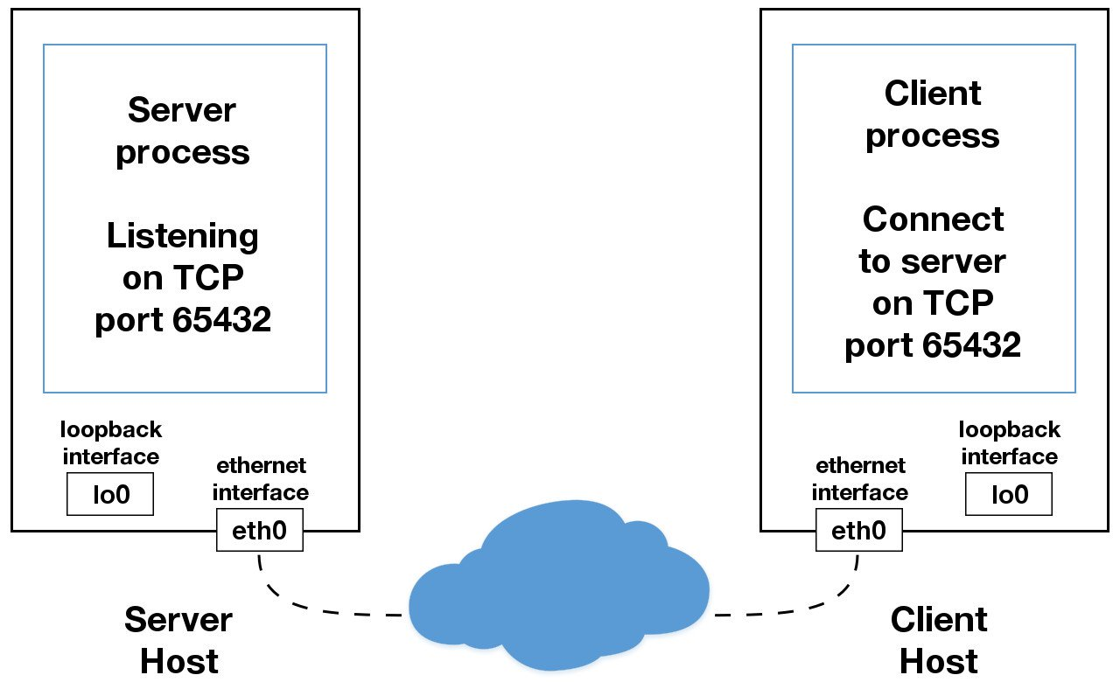

Slide 9
Hands on Session
Client Socket application

Slide 10
Further Approaches
Chatroom for multiple people simultaneously
Encryption
Sending Files over sockets
SocketServer

Slide 11
References
https://realpython.com/python-sockets/
https://www.tutorialspoint.com/python/python_networking.htm
https://www.geeksforgeeks.org/socket-programming-python/
https://docs.python.org/3/library/ssl.html#module-ssl

